Slide 1
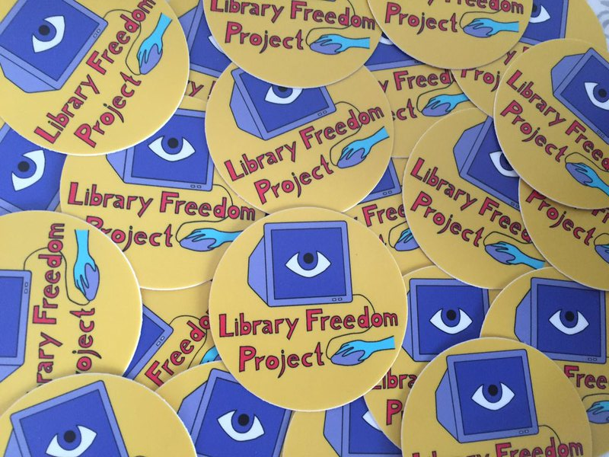
ALL ABOUT TOR FOR LIBRARIES

Slide 2

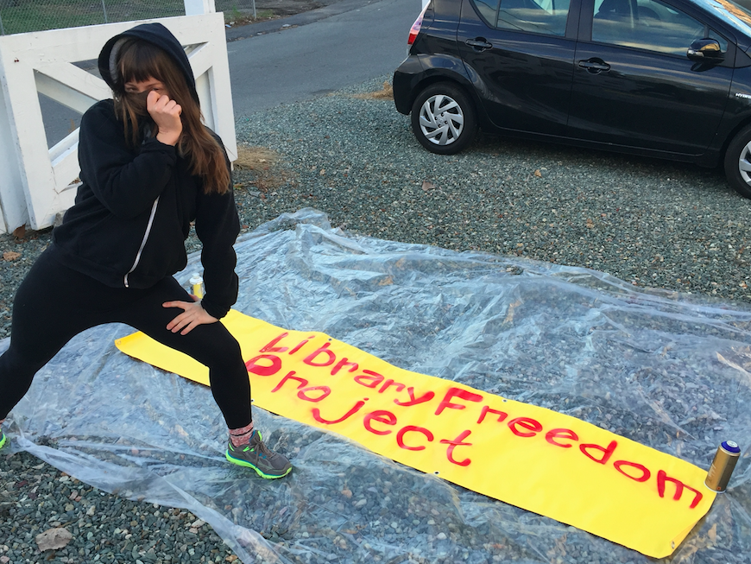
WHO AM I ?
Librarian and internet activist
Started LFP in 2013
Partners with ACLU of Massachusetts
Work with ACLU affiliates nationally
Core contributor, The Tor Project
Library Journal Mover and Shaker 2015

Slide 3

WRITE THIS STUFF DOWN
twitter:
@flexlibris
@libraryfreedom
email:
info@libraryfreedomproject.org
alison@torproject.org
link list: libraryfreedomproject.org/allabouttor
mailing list: lists.riseup.net/www/subscribe/libraryfreedom

Slide 4

WHAT IS TOR?
Free software and an open network
Protects against network surveillance and censorship
Run by a US non-profit and volunteers all over the world
Stylized Tor not TOR
Why do we need it?

Slide 5
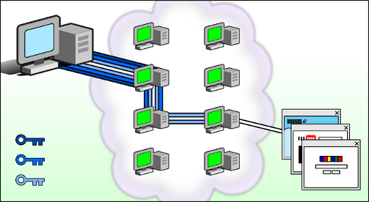
WHAT IS TOR?
Tor the network or “little-t tor”
Presents a SOCKS proxy
Relays operated across the world

Slide 6
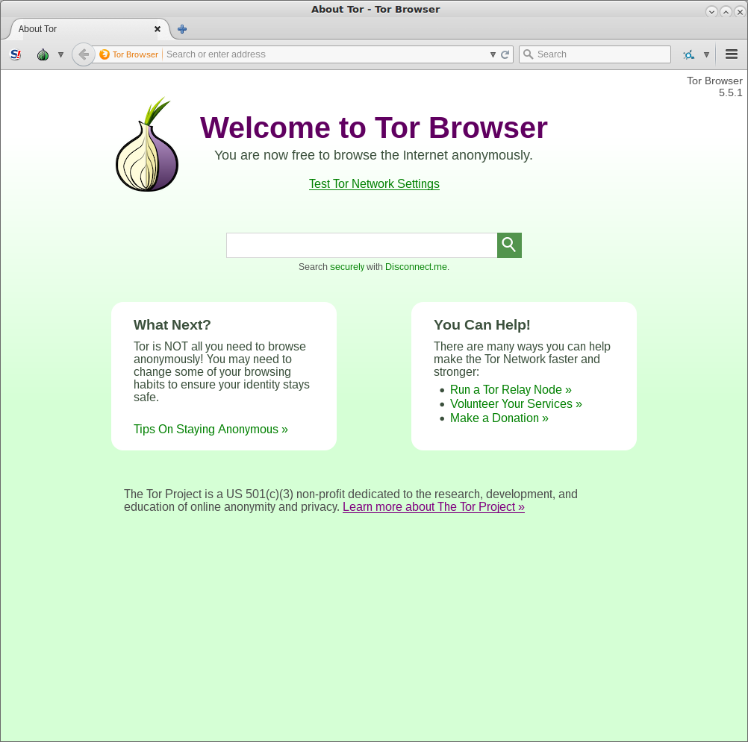

Slide 7
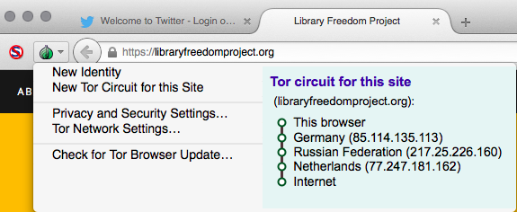
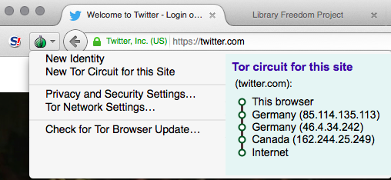
WHAT IS TOR BROWSER?
Obscures your real IP
Prevents network observation of your browsing
Prevents cross-site correlation
Blocks cookies, scripts
Writes nothing to disk
No browser history
Blocks fingerprinting

Slide 8
USING TOR BROWSER
Default search engine: DuckDuckGo
Bundled with: NoScript
Bundled with: HTTPS Everywhere
Don't add any other extensions
Don't enable any plugins (eg Flash)
Best practices
Library use cases

Slide 9
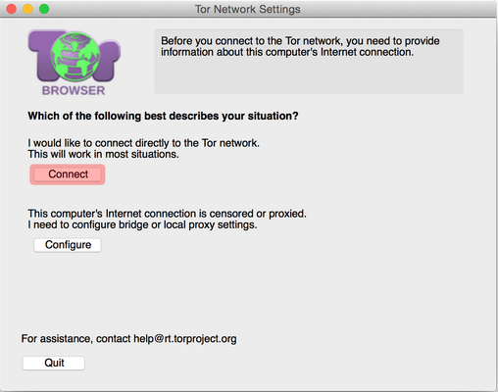
USING TOR BROWSER

Slide 10
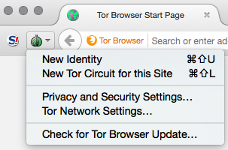
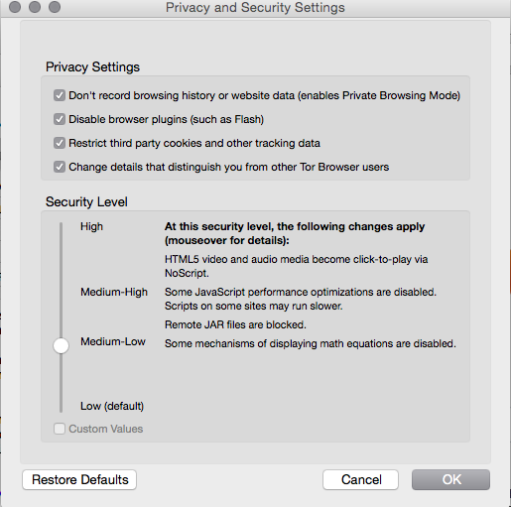
USING TOR BROWSER

Slide 11
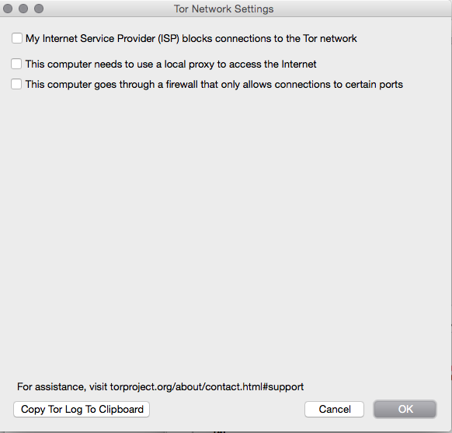
USING TOR BROWSER

Slide 12
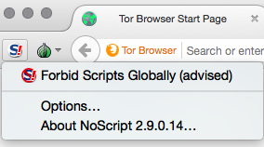
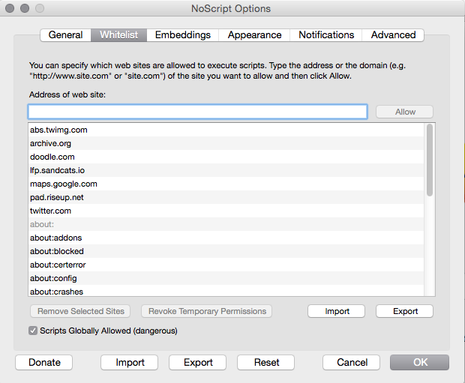
USING NOSCRIPT

Slide 13
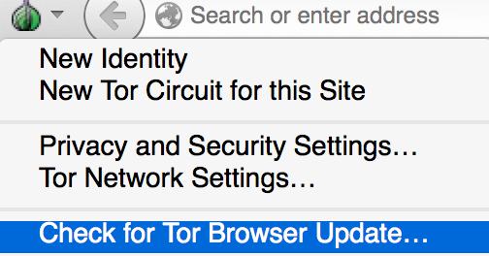
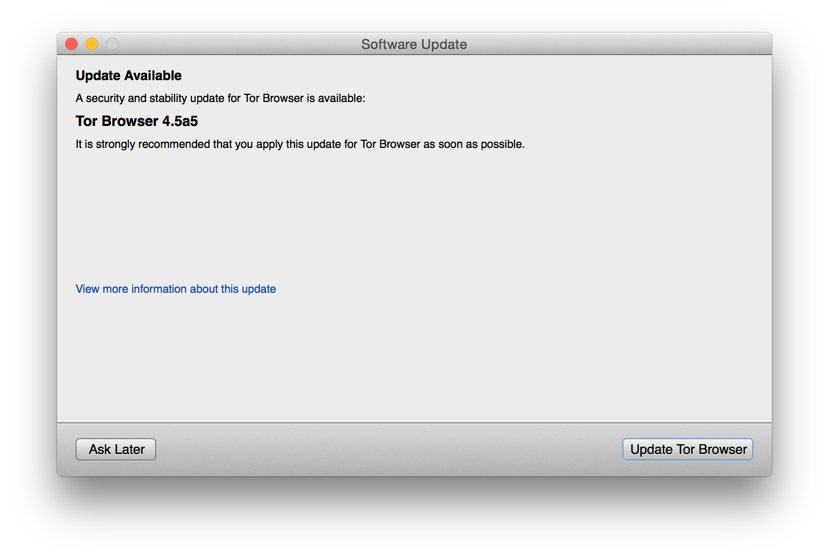
UPDATING

Slide 14
TROUBLESHOOTING
Is your system clock correct?
Is your network censored in some way?
Is your antivirus or firewall blocking it?
Are you already running the browser?
Try reinstalling

Slide 15
TOR RELAYS IN LIBRARIES
How does this help Tor?
Bridges are low risk, high need
Exits are higher risk, highest need
You will need: one PC or VM with Linux Debian, dedicated IP address
Fast relays: 10 Mbytes/s
Won't affect patrons at all
LFP resource packet
We will set this up for you!

Slide 16
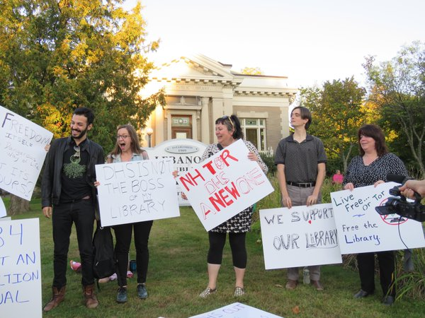
TOR RELAYS IN LIBRARIES

Slide 17
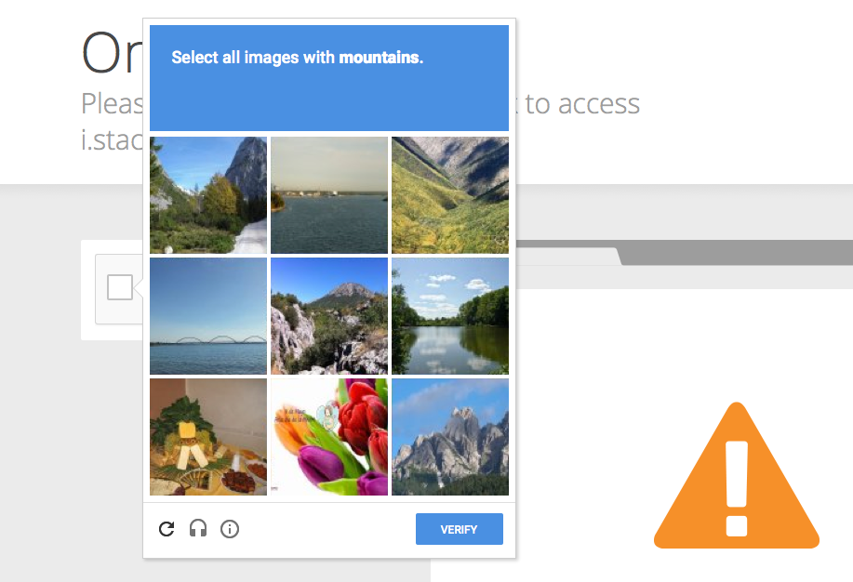
USABILITY ISSUES

Slide 18
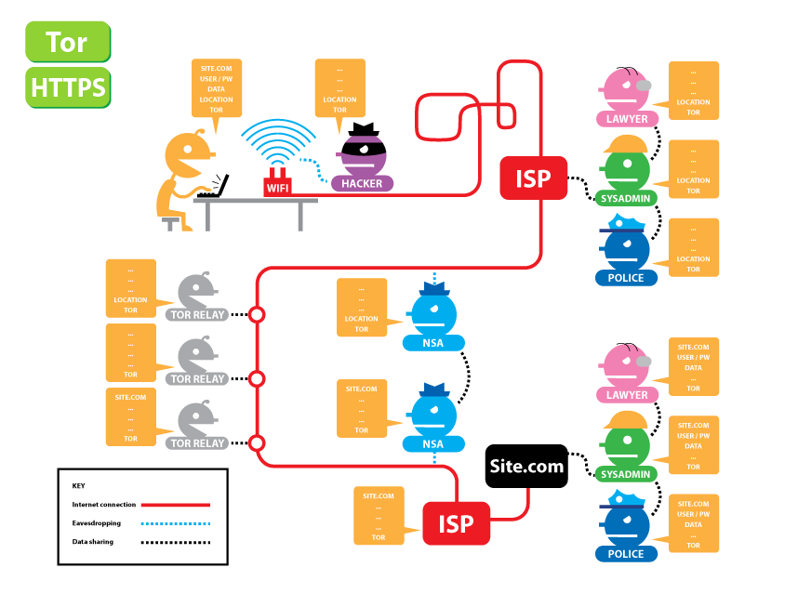
TOR AND HTTPS

Slide 19
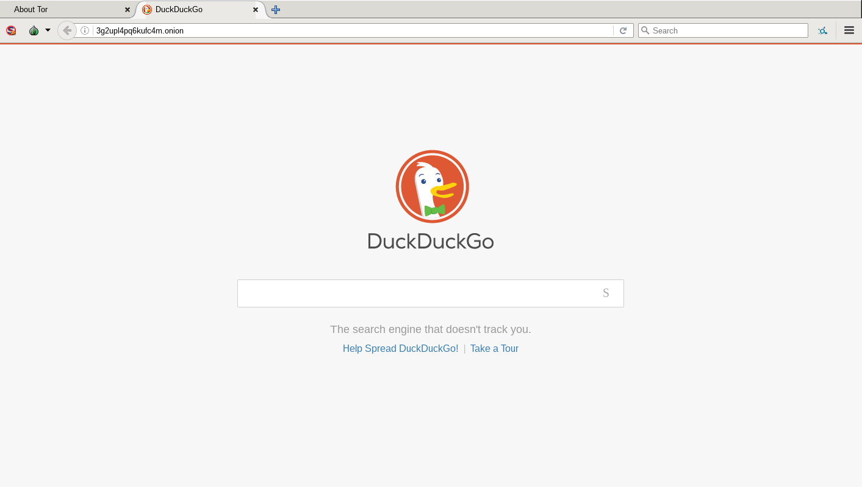
ONION SERVICES
Websites & services only accessible over Tor
.onion special-use TLD
Protection for user and server
Server IP/location not traceable
Can't be censored or operators identified
Encrypted in Tor cloud: no need for HTTPS
Solves some of the problems with DNS
Library use cases

Slide 20

CIRCUMVENTING CENSORSHIP
Gettor robot
Bridges and pluggable transports
LFP letter to convince IT/city to unblock Tor
Tor will subvert library computer filters!
Tor Browser will run from a flash drive

Slide 21
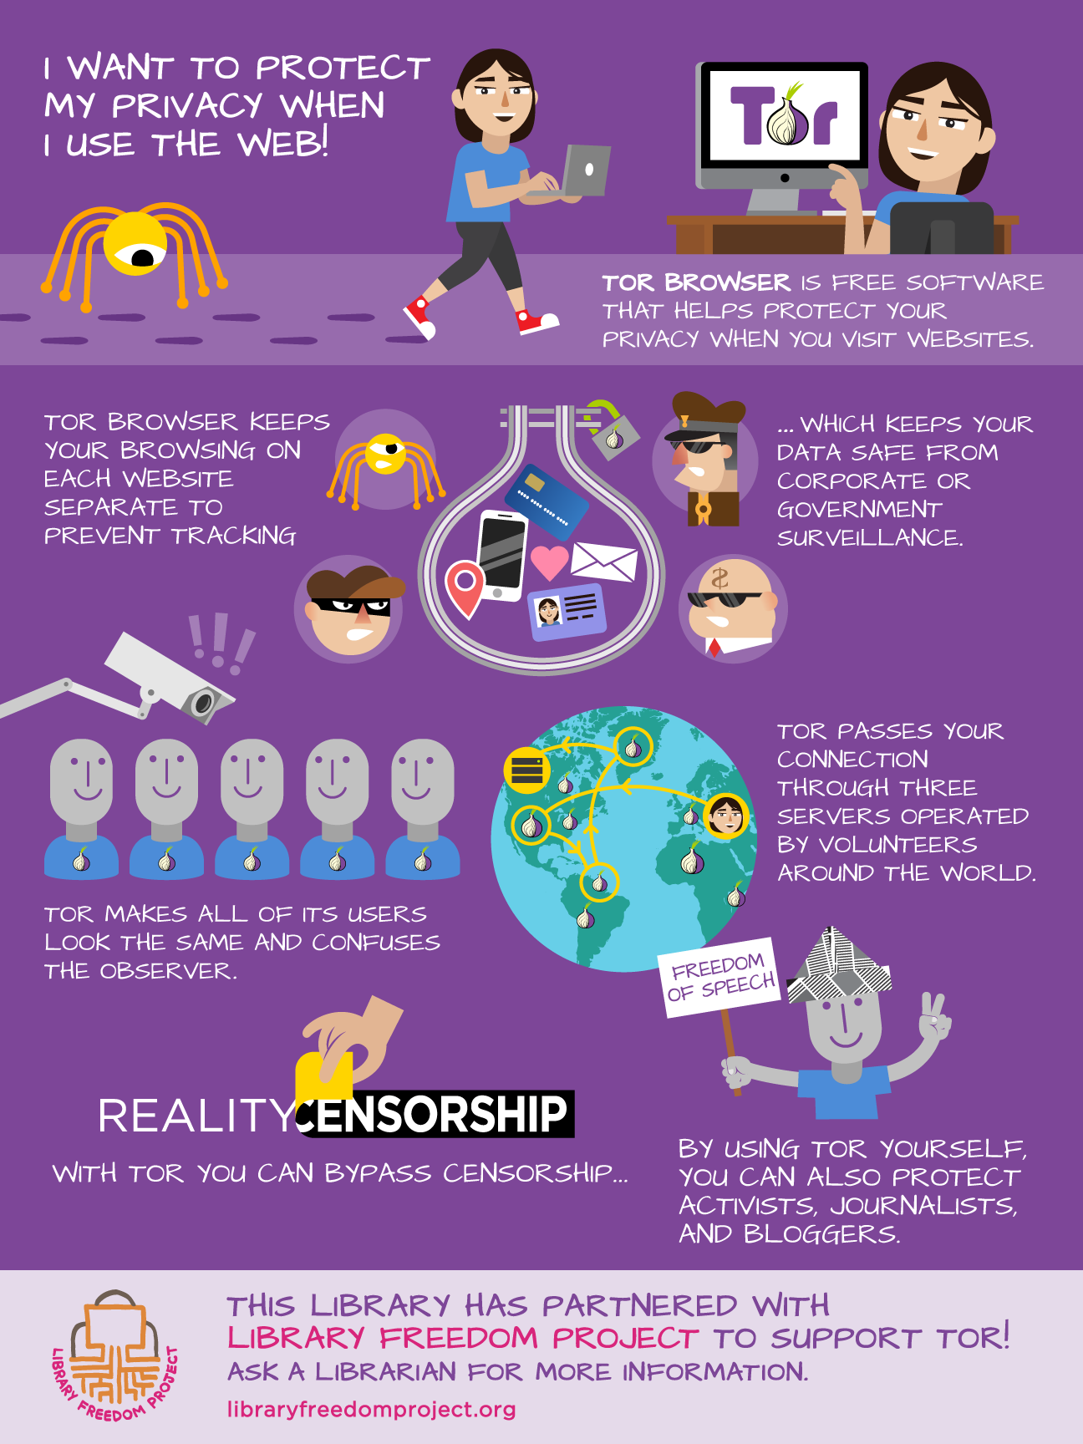
Use Tor in your library and LFP will send you this lovely poster!!

Slide 22
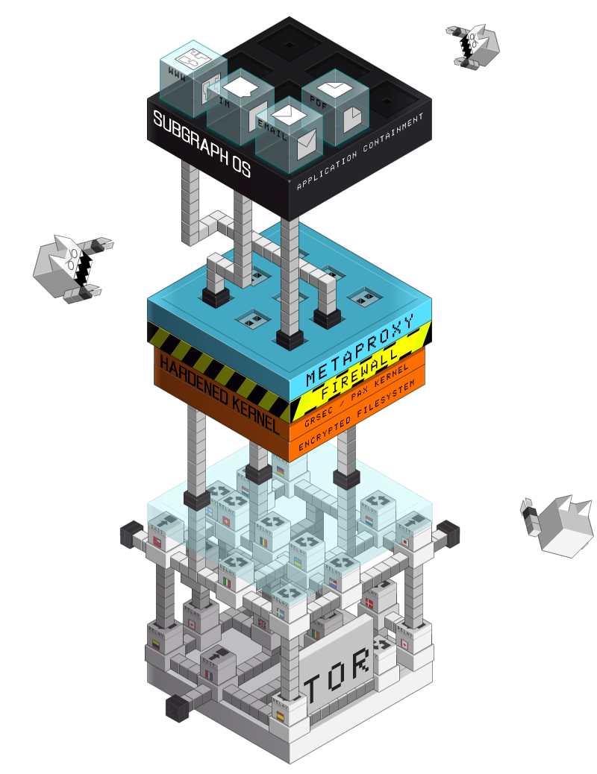

EVEN MORE TOR
Orbot (Tor for Android)
TorBirdy
Tor Messenger (beta)
ExoneraTor
Subgraph OS (alpha)
Tails OS
Metrics
OONI
Social contract
Support portal (coming soon)

Slide 23
Questions? Feedback?
Need more help?
link list:
libraryfreedomproject.org/allabouttor
mailing list:
lists.riseup.net/www/subscribe/libraryfreedom
contact:
@flexlibris
@libraryfreedom
alison@torproject.org
alison@libraryfreedomproject.org

